Slide 1
User Manual Book My Room

Slide 2
Set Device Setting

Slide 3
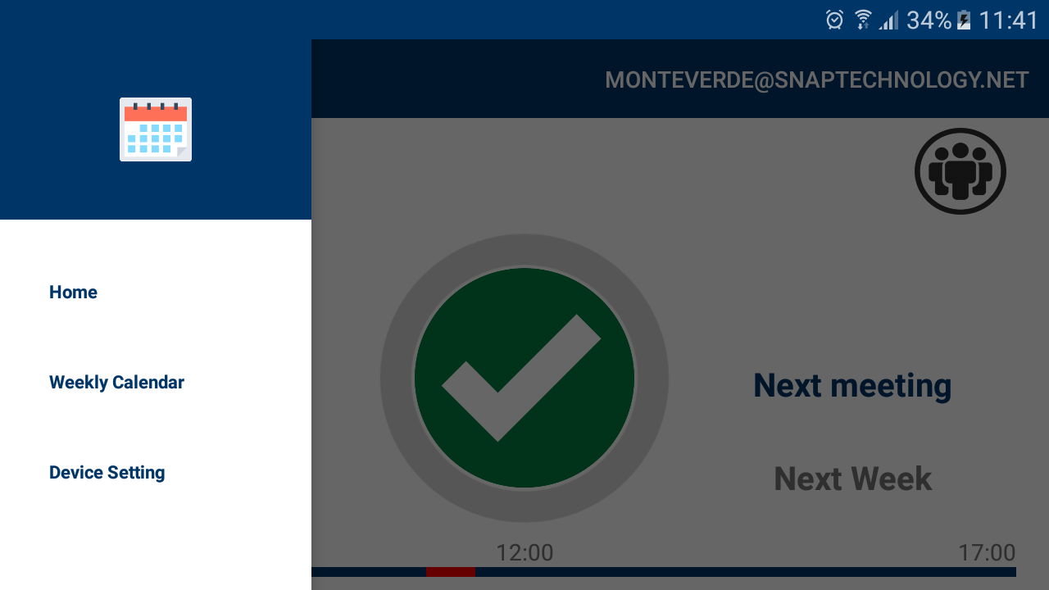
Set Device Setting
Click on Device Setting from the menu

Slide 4
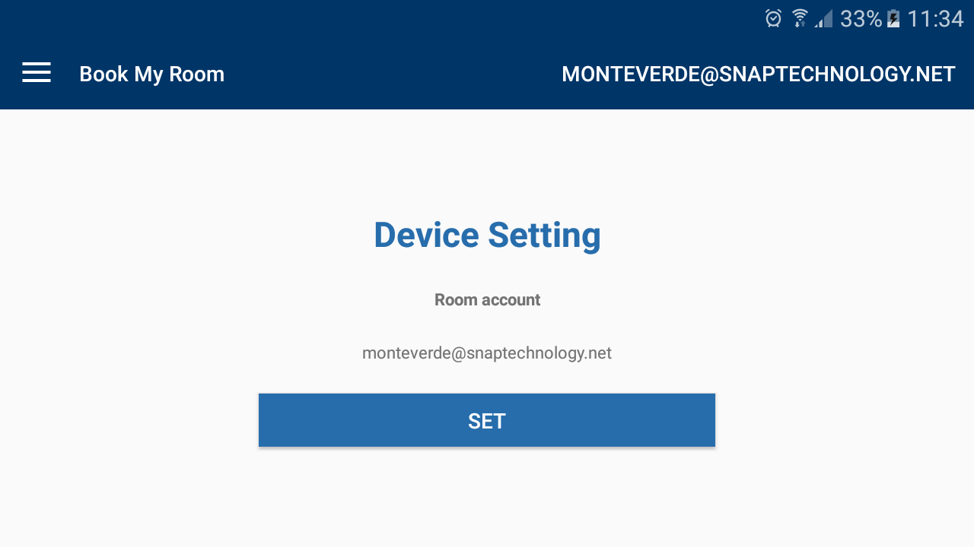
Set Device Setting
Click on button SET

Slide 5
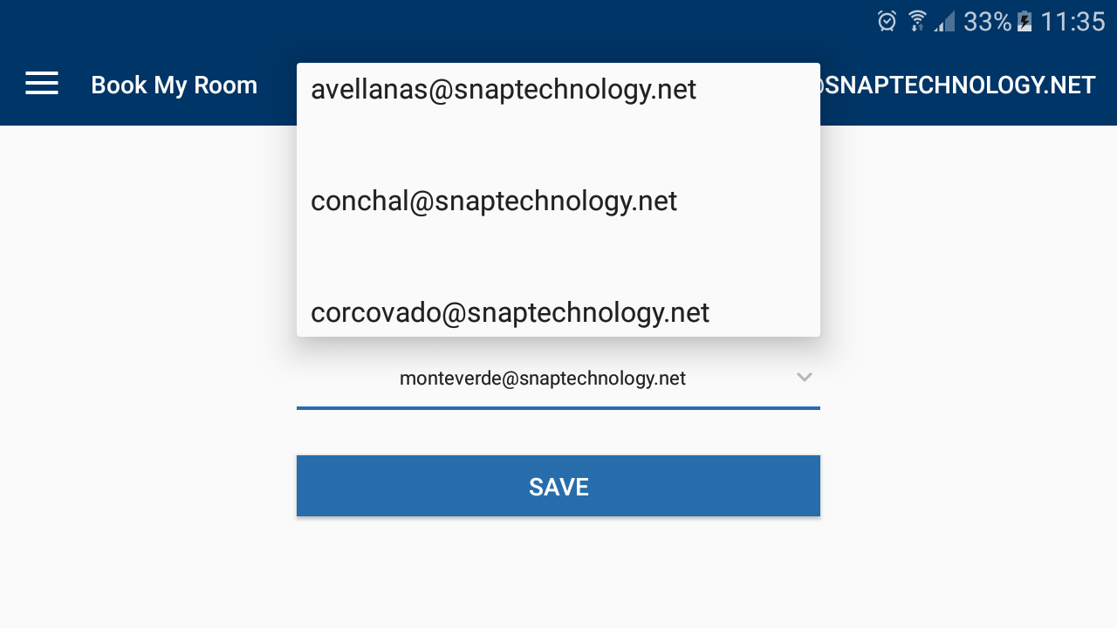
Set Device Setting
Choose a room account and click on button SAVE

Slide 6
Add new meeting from home screen

Slide 7
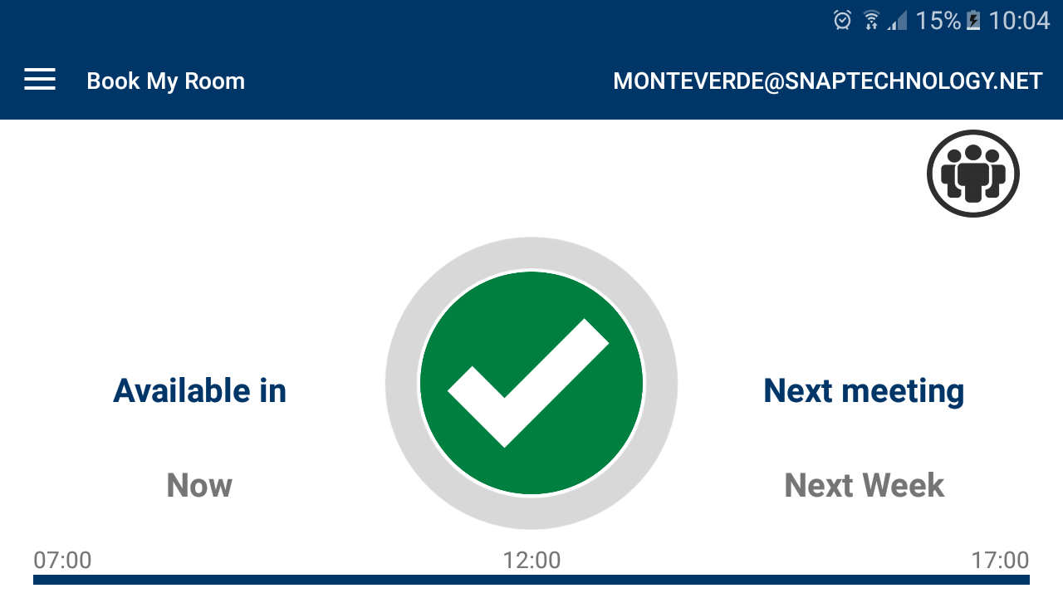
Add new meeting from home screen
Click on the green circle

Slide 8
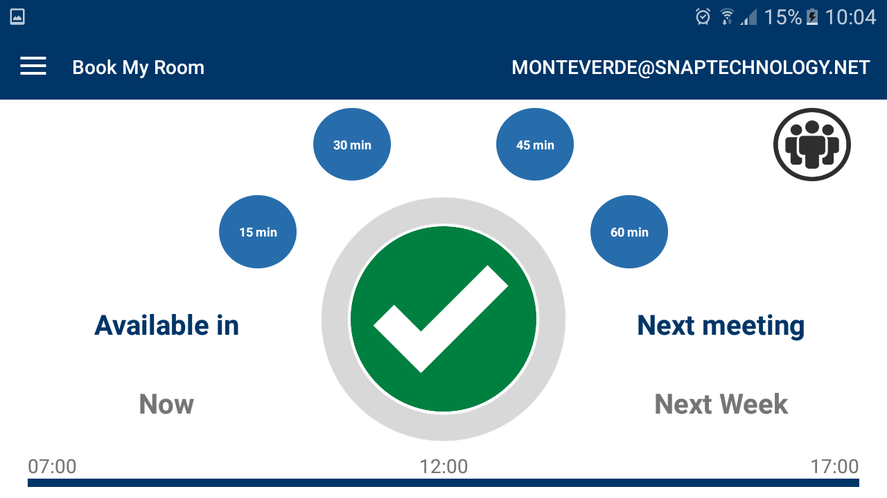
Add new meeting from home screen
Choose the meeting time

Slide 9
Delete a meeting from home screen

Slide 10
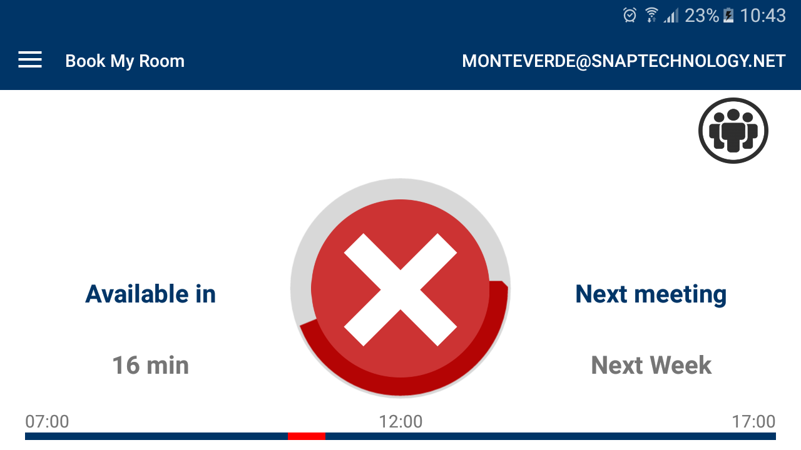
Delete a meeting from home screen
Click on the red circle

Slide 11
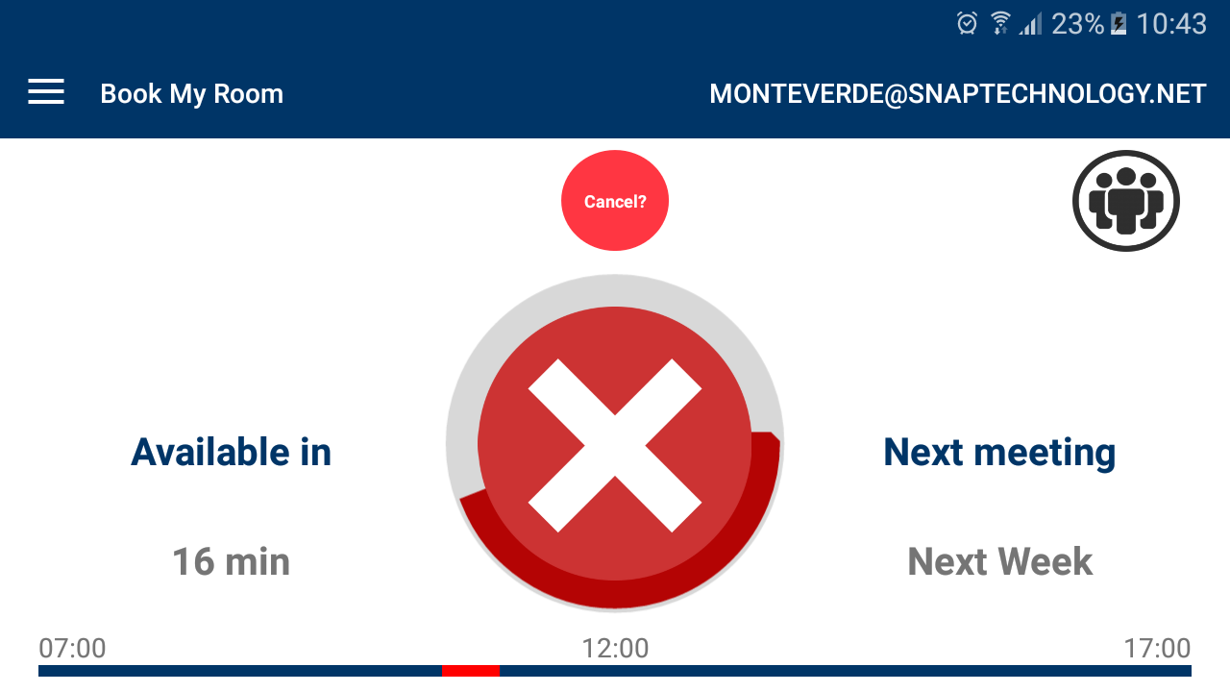
Delete a meeting from home screen
Click on button cancel?

Slide 12
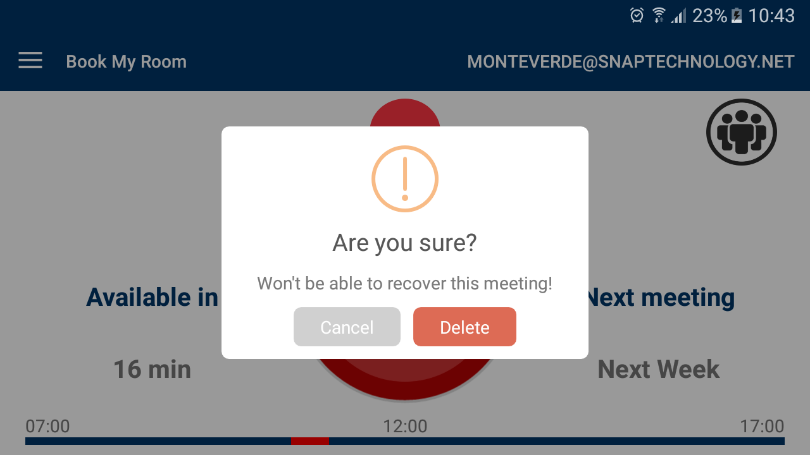
Delete a meeting from home screen
Click on button DELETE

Slide 13
Show Attendees from home screen

Slide 14
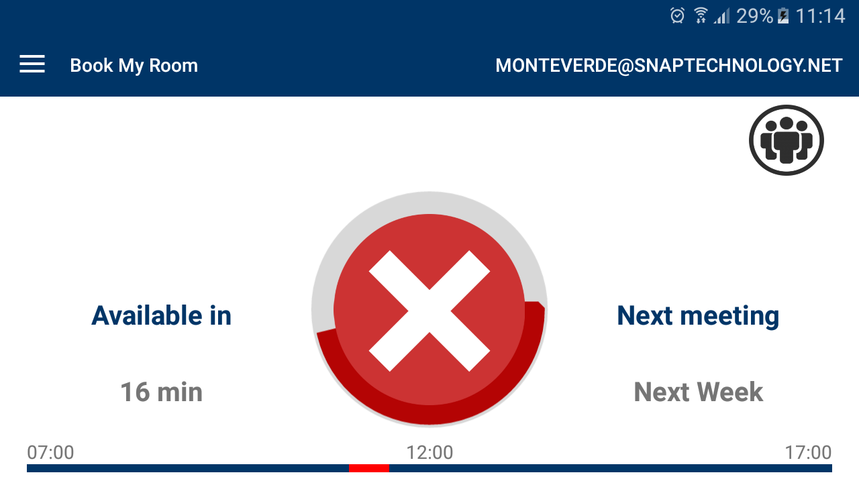
Show Attendees from home screen
Click on icon people

Slide 15
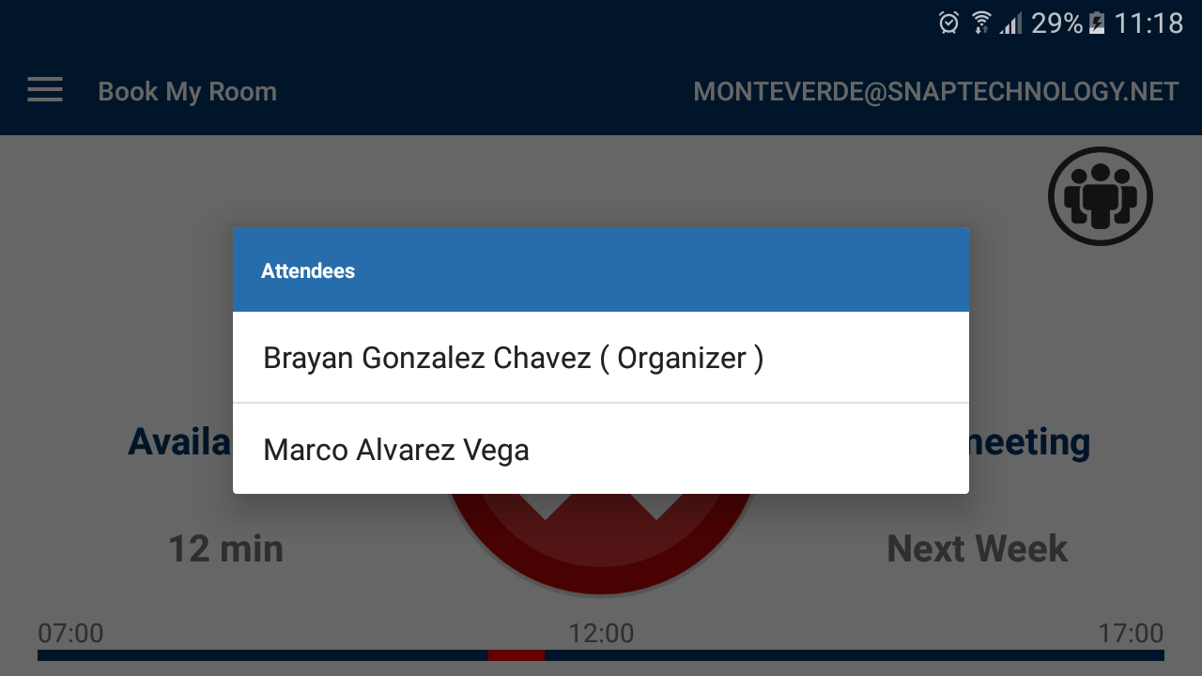
Show Attendees from home screen
The attendees are showed

Slide 16
Add new meeting from home Weekly Calendar

Slide 17
Add new meeting from home Weekly Calendar
Click on Weekly Calendar from the menu

Slide 18
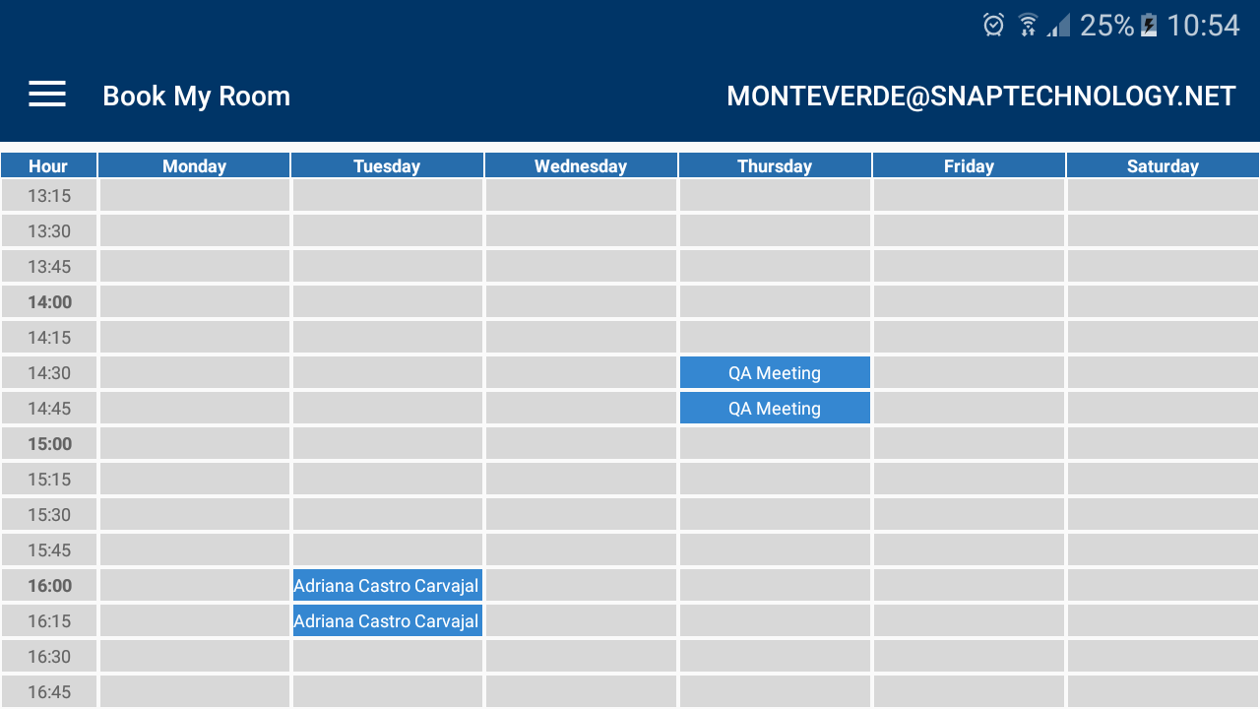
Add new meeting from Weekly Calendar Screen
Click on an available space.

Slide 19
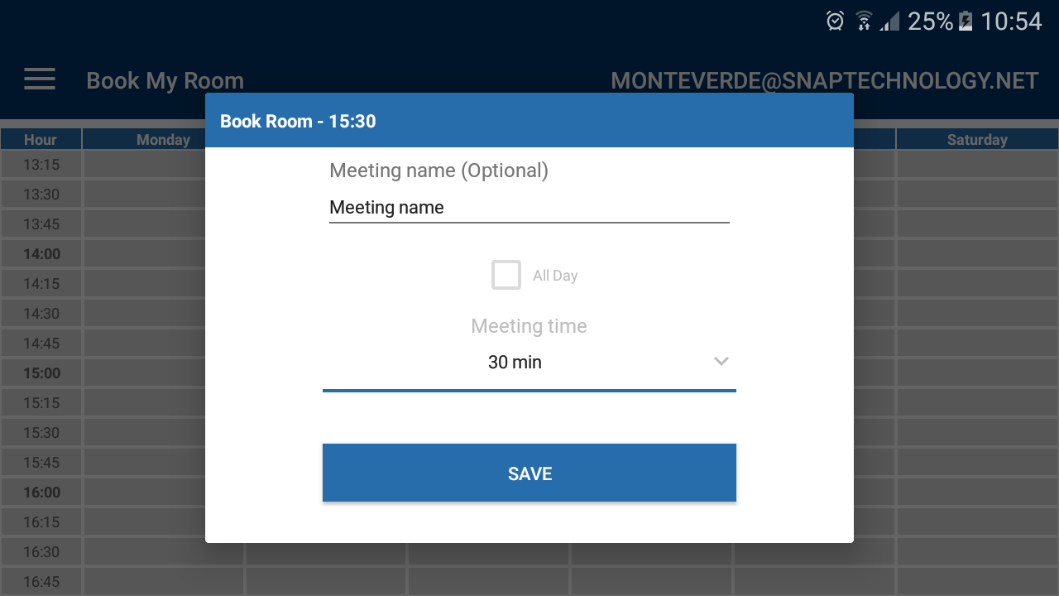
Add new meeting from Weekly Calendar Screen
Fill out the fields and click on button SAVE

Slide 20
Update a meeting from home Weekly Calendar

Slide 21
Update a meeting from home Weekly Calendar
Click on Weekly Calendar from the menu

Slide 22
Update a meeting from Weekly Calendar Screen
Click on a meeting.

Slide 23
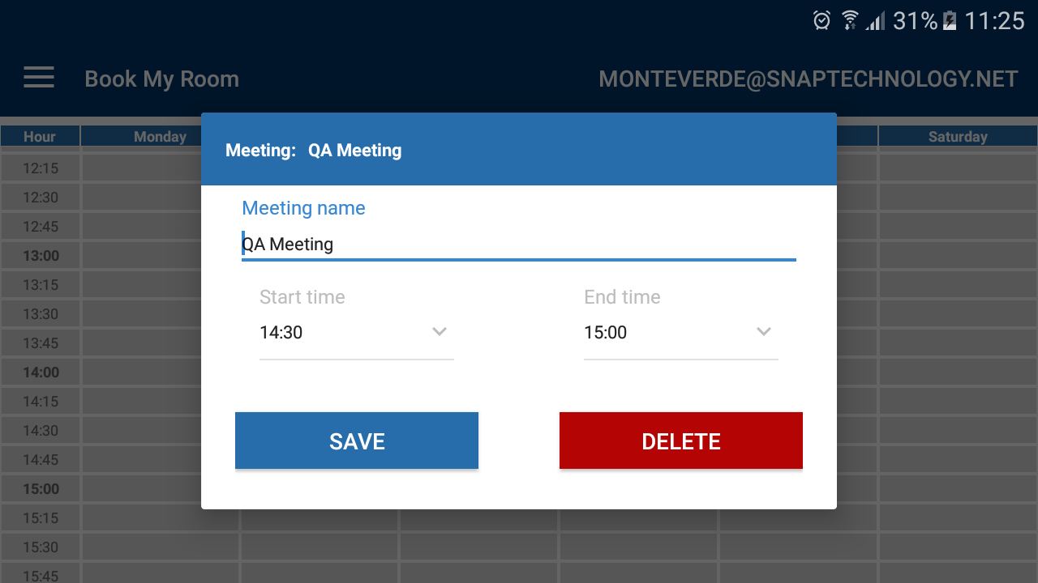
Update a meeting from Weekly Calendar Screen
Update the fields that you want and click on button SAVE

Slide 24
Delete a meeting from home Weekly Calendar

Slide 25
Delete a meeting from home Weekly Calendar
Click on Weekly Calendar from the menu

Slide 26
delete a meeting from Weekly Calendar Screen
Click on a meeting.

Slide 27
Delete a meeting from Weekly Calendar Screen
Click on button DELETE

